Slide 1
AR Animals
COMP1869

Slide 2
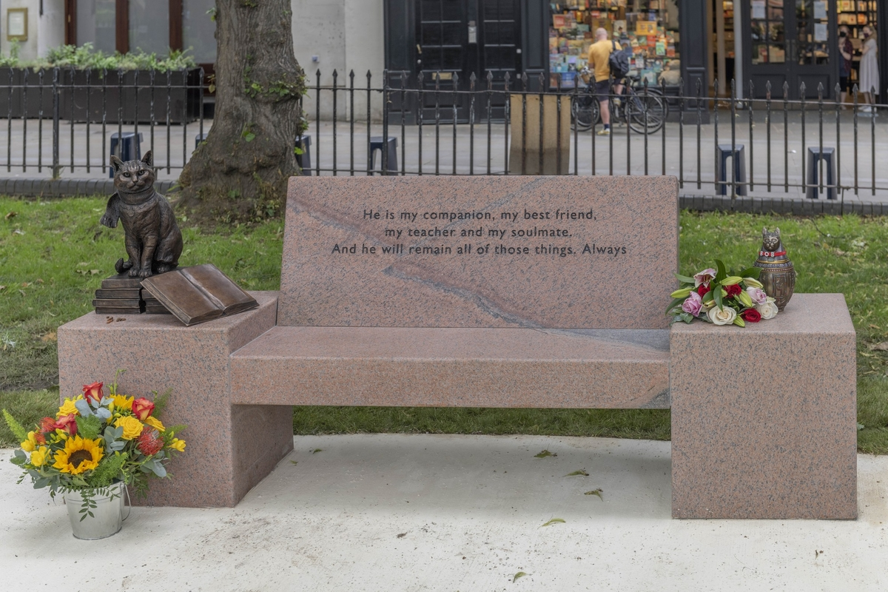
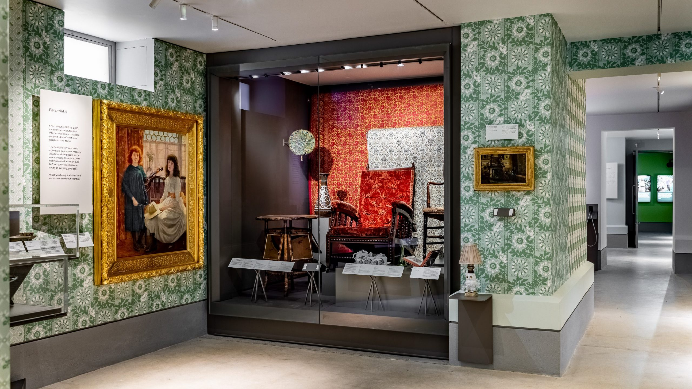
Brief Overview
Our brief was made by Typeone and they required us to make 3 3D, low-poly models for their game engine “PlayCanvas” These were a parakeet, a fox and a cat named “Bob the Streetcat” from a book of the same name. These models will also require rigging and animations for their movement.
They want the models for use in the “Museum of the Home”, a Museum in London with some emphasis on the environment and nature in general. They want them as part of an exhibit that uses AR technology that they plan to implement themselves using the models on behalf of the Museum.
The models are to be made in Blender so they are compatible with the PlayCanvas engine, but our game will be made in Unity and use these same models so we can demonstrate them in action.
To expand our brief, we decided we would have these animals exploring up to three different environments around London, but starting off with just one sandbox area.

Slide 3
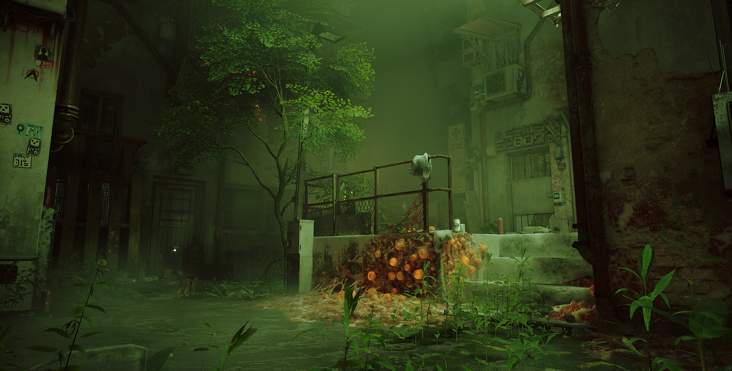
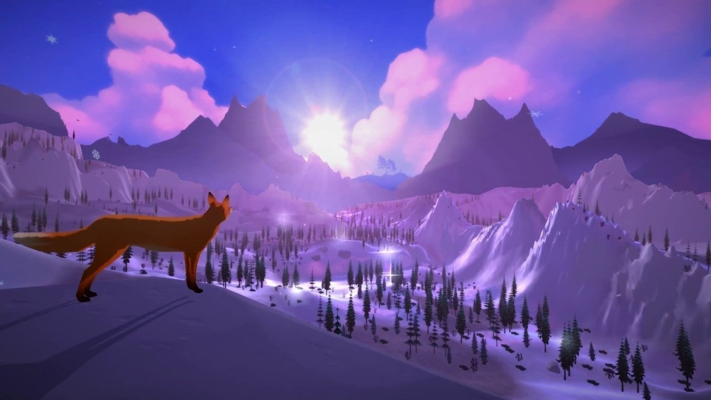
High Concept
AR Animals is a exploration focused game like Stray and “The First Tree”. The player will play as either a cat, a parakeet or a fox as they make their way through the environment. They have been displaced from their homes and now need to get back to their families. Your goal is to navigate the environments using each of the animals and bring them back to their families.
Despite this, there is little sense of urgency. Instead, the focus is more on the immersive environment and educational aspects of the game, which makes sense for the Museum target audience.

Slide 4
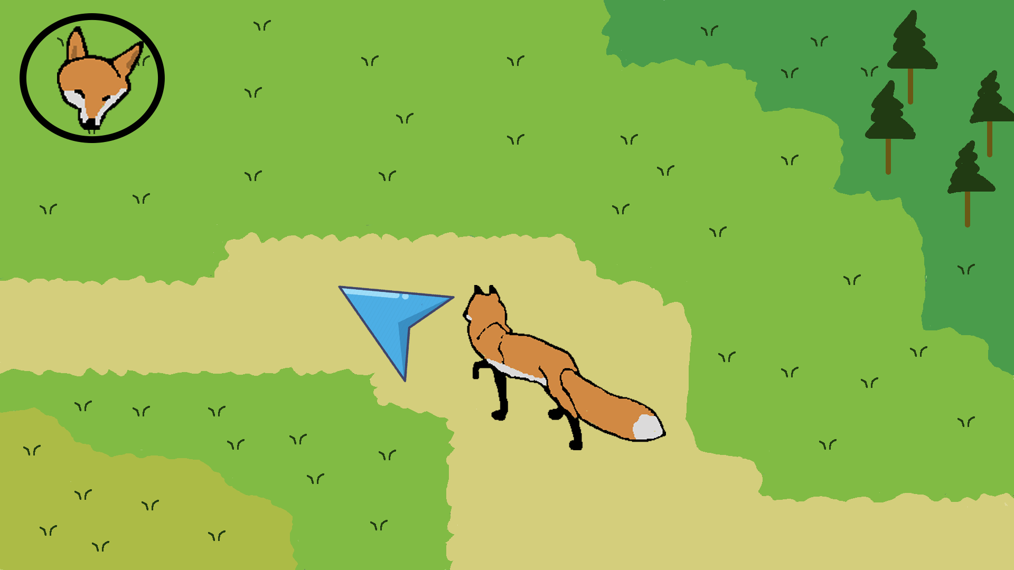
Gameplay
The player will be able to point and click to direct the animals on computer and on their phone they'll be able to press on the screen where they want the animals to go
Each animal will have a unique ability that will let them pass through specific obstacles.
The players will get full freedom in the levels, letting them explore for as long and for as much as they want.
Dialogue boxes would also appear that provide accurate information on the flora and fauna present to increase the educational aspect of the game

Slide 5
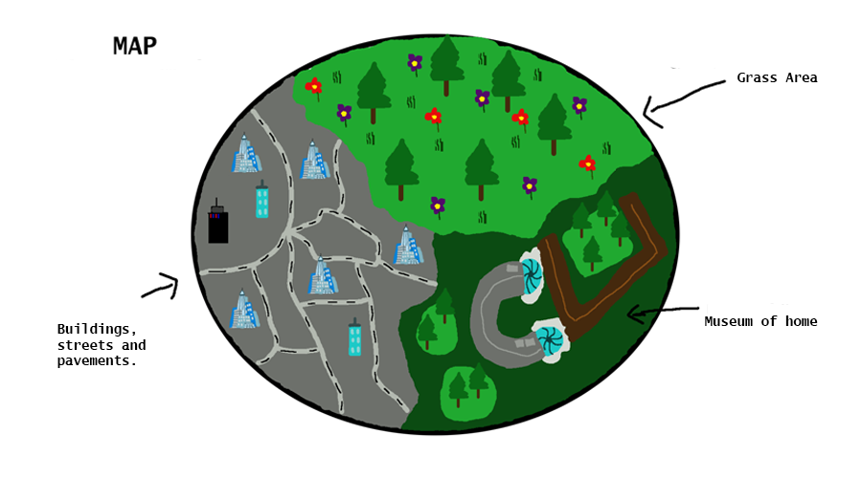
Look and Feel
This game will mainly have a low-poly look to it to ensure that the models we use do not exceed 50,000 polygons. The levels will explore rural london around the Museum of the Home, Central London with the high rise buildings and busy streets, and it will also have a forest area to show the greener side of London. Each level should have a homely and warm feeling as the player goes through it, trying to get the animals back to their families.

Slide 6
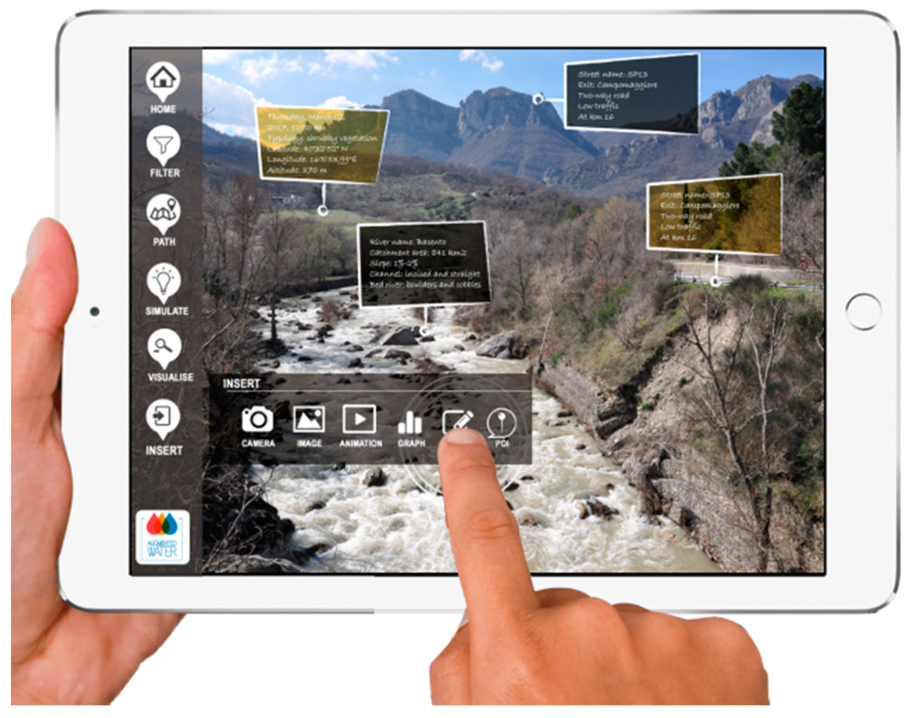
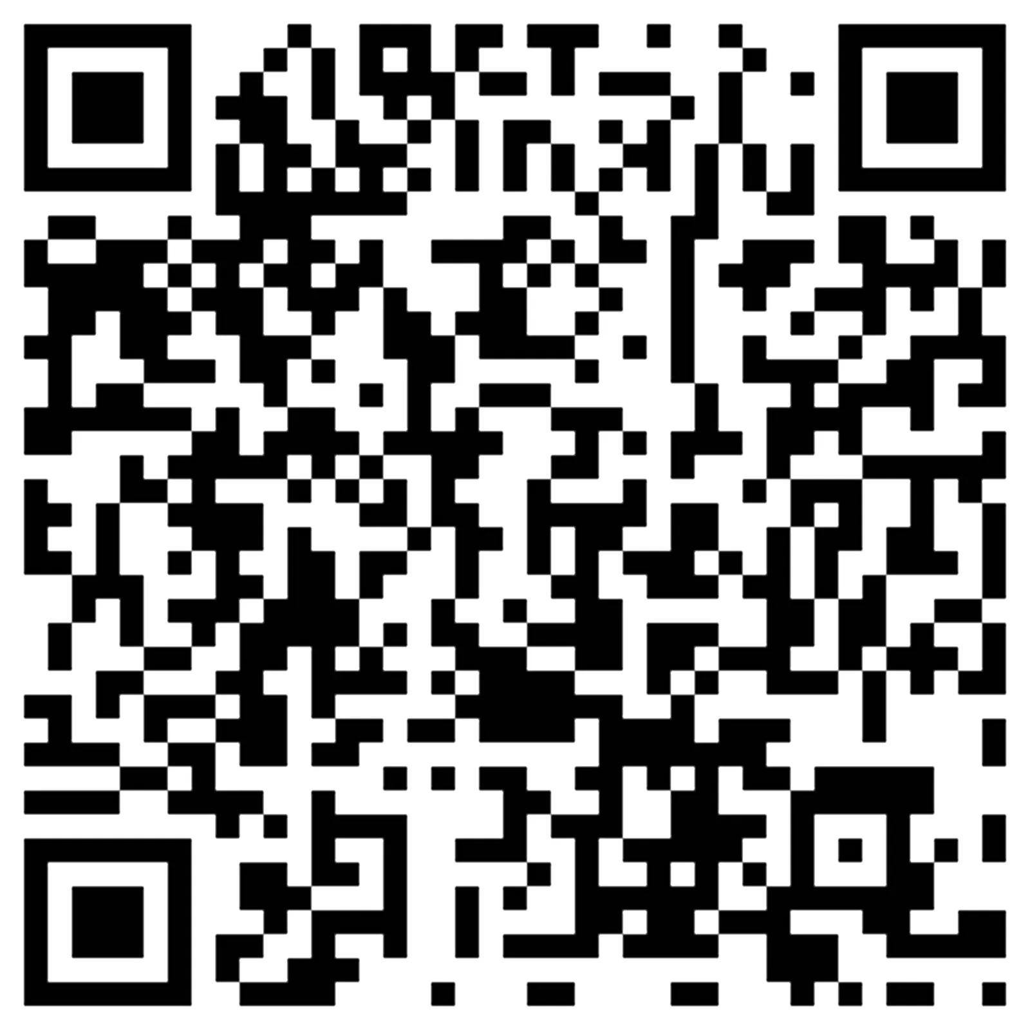
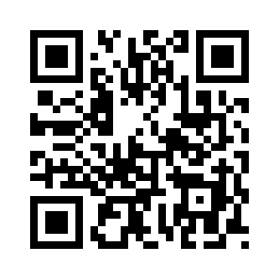
AR Implementation
Since Typeone planned to implement the models into the Museum of the Home as an AR experience, we will simulate this a bit ourselves by having QR codes you can scan both in the real world and in game. The real world QR codes would allow you to enter the game on mobile at certain spawn positions with a specific animal. These could then be placed in real life at different locations. The in-game QR codes would provide a link to relevant media and information around the flora and fauna in the surrounding area.

Slide 7
Deliverables
3 Low Poly + High Quality models of Bob the Streetcat, a Parakeet and an Urban Fox, fully textured and animated, compatible with the PlayCanvas engine
A playable sandbox within Unity that allows you to play as the 3 characters in an urban environment.
Simple controls and movement system for the 3 animals to make them as accessible as possible as well as opening up mobile support
Popups in game to display accurate educational material relating to the Flora and Fauna found in game
A custom low-poly model of the exterior of the “Museum of the Home” to include in the background
Stretch Goals (Not necessary for the prototype but would be nice to include)
QR code support both for accessing the game, as well as in-game to provide information (AR)
More complex AI for the animals and human crowds to add more realism and immersion in the environment
Weather effects, more graphical polish
More fleshed out individual levels for each character

Slide 8
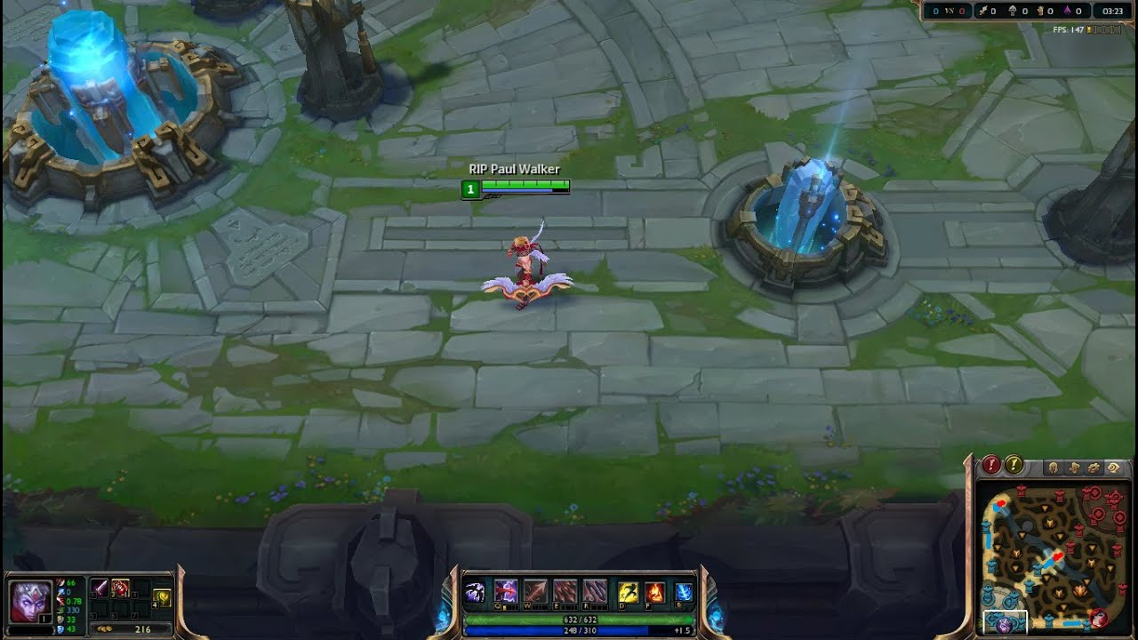
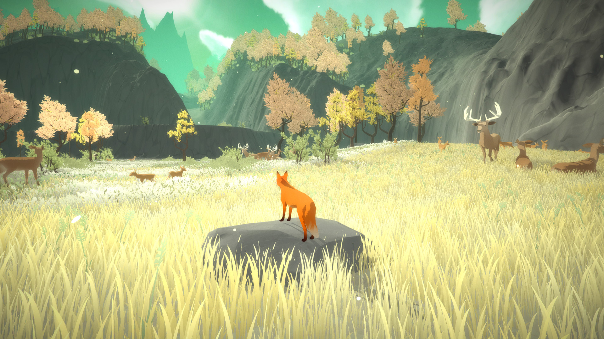
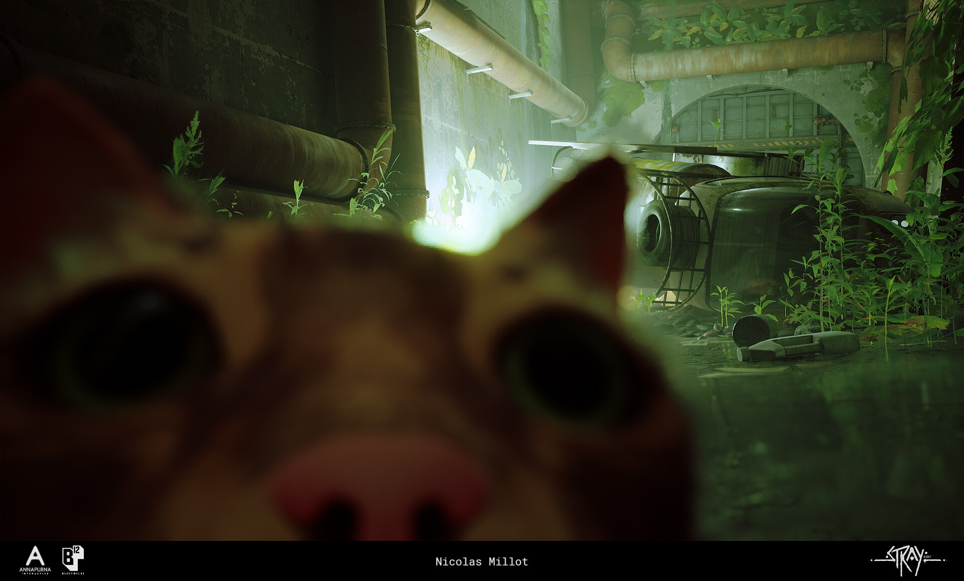
References
“League Of Legends” - We are basing our camera perspective on the one this game uses
“The First Tree” - An artistic low-poly game in which you play as a fox and navigate around the natural scenery, which bares a lot of similarities to how we would like our prototype to look and feel like.
The First Tree - Launch Trailer - Nintendo Switch (2018)
“Stray” - Another very artistic game which puts you in the perspective of a small animal exploring an environment, except it is a more urban environment, which helps us with inspiration on how to have our cat navigate that kind of environment in London.

Slide 9
Key Contacts and Conclusion
In short, we think our prototype is very deliverable in the time given, as at the core, the minimum viable product is just 3 low-poly animal models with rigging and animations, a character controller for each, and a urban environment for them to explore and do basic interactions with. However, from that point, there is lots of room to expand it to add more immersion and visual polish.
Project Lead, Modelling
Rhys
Modelling, Animations, Textures
Rio
Modelling, Textures
Dana
Programming
Elijah
Programming
Zach

